Slide 1



Tight Pickle Productions

Slide 2
Trailer

Slide 3
The game itself

Slide 4
Play test results
Feedback
Negative / positive
Improvements

Slide 5

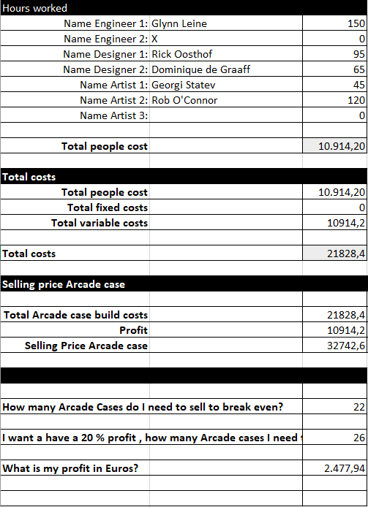
Cost Calculations
Hours put in
Costs
Arcade casing
Profits

Slide 6
Trello
https://trello.com/b/hwzg7ors/project-lift-off

Slide 7
Glynn Leine (engineer)
Everything that has to do with coding
Arduino

Slide 8
Dominique de Graaff (designer)
PowerPoint presentations
Website
Game and trailer synopsis
Create the design for the speaker and light output
Laser cut the board (CaseDesign)
Playtest
GameDesign

Slide 9
Rick Oosthof
Create the controller
Level Design
Electrical Enginenering

Slide 10
Rob O’Connor
Art stuff
Filming and editing the trailer
Scrum Master
Animation
Pictures

Slide 11
Georgi Statev
Art stuff
Tilesheets
Animation
Poster

Slide 12
Teamwork
Reflection
Communication could be better
Be at school on time
Peer assessment
Roles (examples)

Slide 13
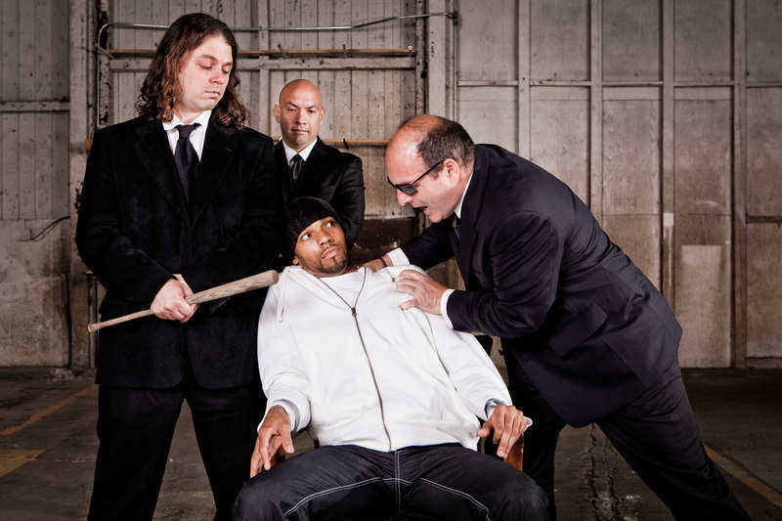
Questions?

